Slide 1

Welcome to
Rotary Club Action Plan
DG Cliff Berg

Slide 2

The Rotary Action Plan
Notes:
Good Morning, my name is Cliff Berg. I serve as your District Governor. First of all, I want to thank all of you for taking on this leadership role. As John has
probably already told you, being Club President is the best job in Rotary. I have been a Rotarian for 52 years, having belonged to 3 different clubs. Currently, I
belong to the Rotary Club of Ocean City-Berlin. I have served as President of 2 of those clubs. I am retired, but in my professional life, I was a principal in a
Financial Planning firm.
We all have different stories about what brought us to Rotary, and what keeps us in Rotary. But we share a common bond:

Slide 3
Together, we see a world where people unite and take action to create lasting change—across the globe, in our communities, and in ourselves.
Notes:
“Together, we see a world where people unite and take action to create lasting change — across the globe, in our communities, and in ourselves.”

Slide 4
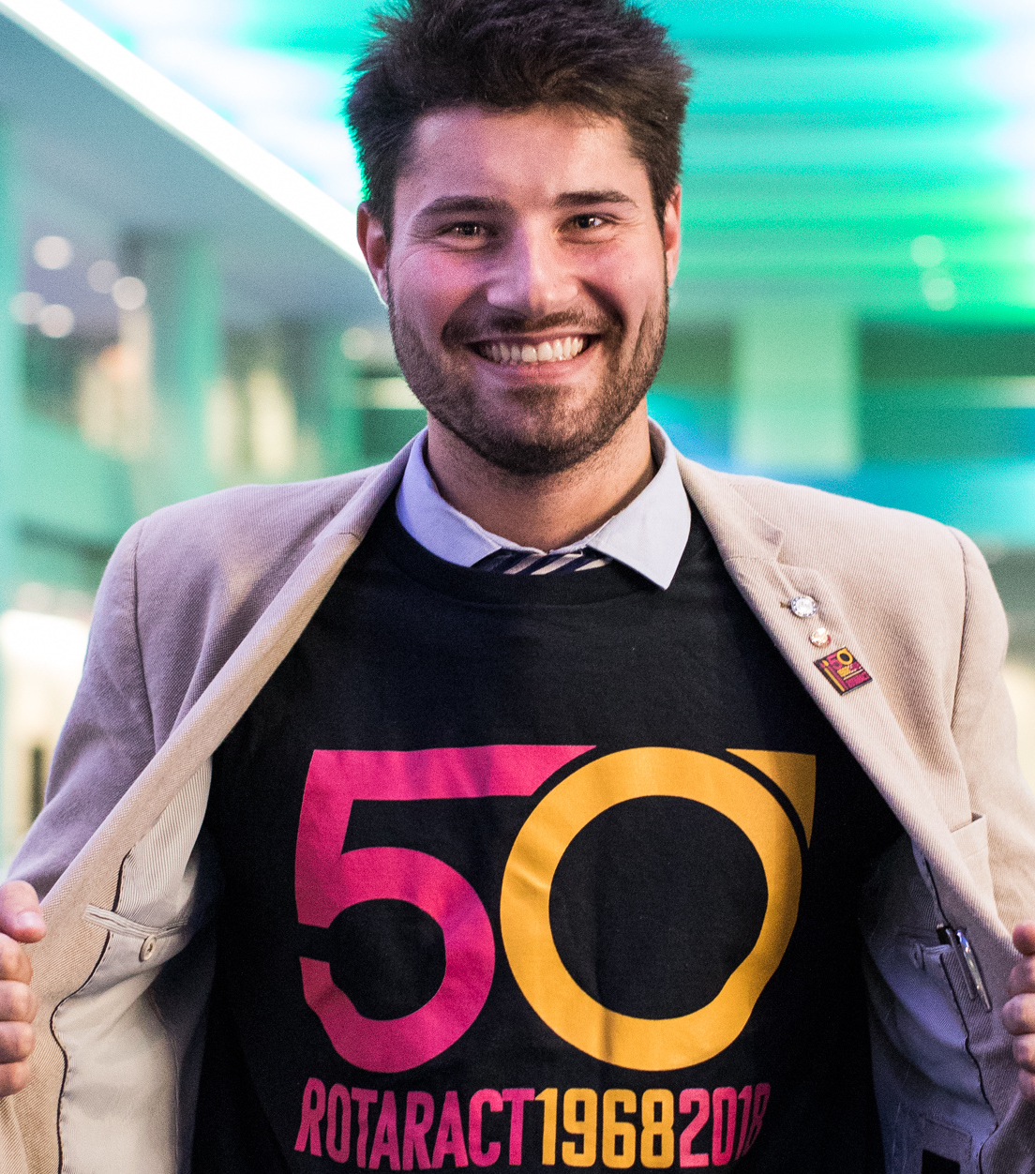
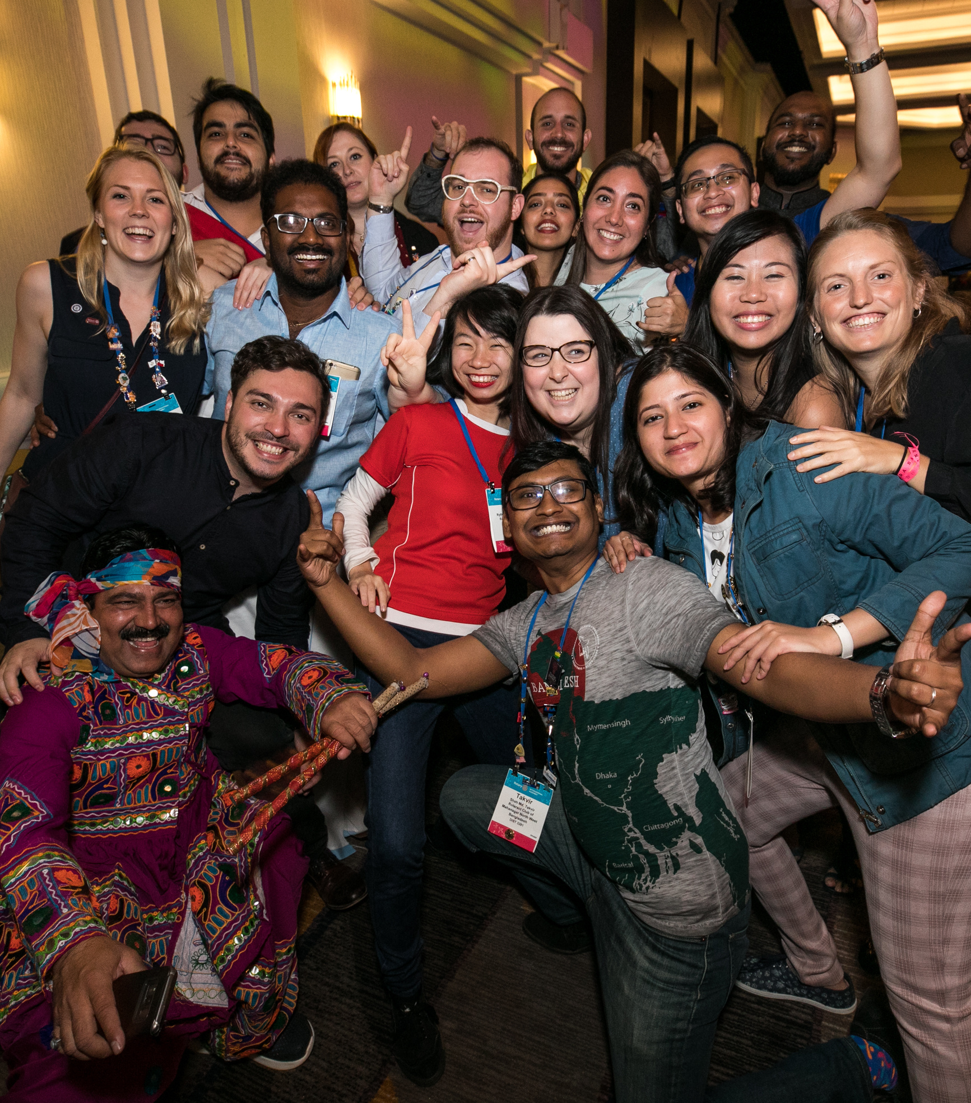
Notes:
Individually and collectively, we are People of Action.
I’m here to talk to you about our plan for Rotary’s future. Because we know that there’s a big gap between who we are as an organization today and who we need and want to be. Before we get into the Action Plan itself- a little background

Slide 5

Notes:
Rotary began developing this plan by taking a look in the mirror, asking hard questions, and making self-assessments. We conducted focus groups and surveys
and asked more than a million members, leaders, and Rotary participants across the world to share their input with us. Our goals were shaped by the feedback of
who know us best – and who already share our commitment to achieving our vision. We learned that our members thought we needed to become more nimble,
more open to new ideas and faces and better about capitalizing on changing technologies and trends.

Slide 6















ARG
AUS
BRA
CAN
FRA
DEU
IND
ITA
JPN
KOR
NGA
ZAF
TWN
GBR
USA
Notes:
But we knew we also had to look outside of Rotary. Here’s what we found out when we surveyed the general public in 2015. We talked to people in 15 countries
around the world. We asked what would motivate them to join a service organization. Here’s what they told us:

Slide 7
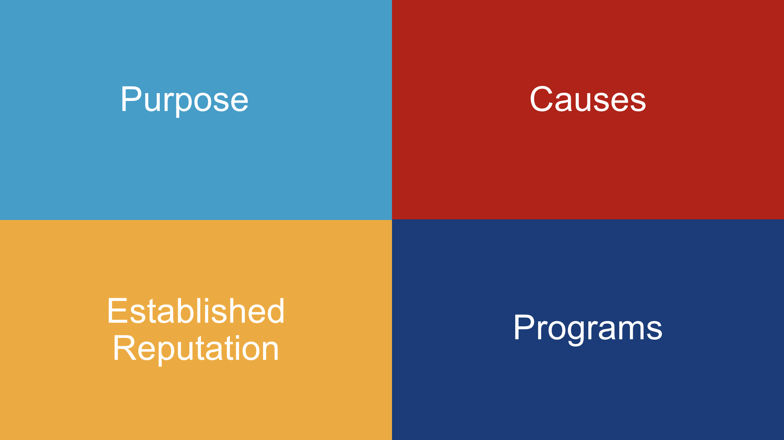
Notes:
The Organization had to have
A sense of purpose and opportunity for community service. and
Causes that are important to them.
It had to have an established reputation—a strong heritage and
Programs that make a difference locally.
Sounds a lot like Rotary, doesn’t it?

Slide 8
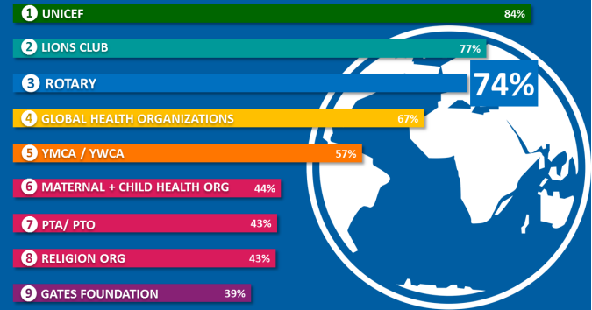
Notes:
We asked if they had heard of Rotary and found out that our global awareness is outstanding: in fact, three out of four people surveyed were aware of Rotary.
Among the world’s leading social service organizations, we’re in the top 3 in terms of awareness. And people know enough about us to know that we do good in
the world. Now for the challenges.

Slide 9
Only 35%
Rotary is an organization for people like me.
Notes:
Most had only a vague idea of exactly how we do good in the world. Only 35 percent saw Rotary as an organization for people like them.”

Slide 10
Only 25%
Know someone in Rotary
Notes:
And just 25 percent of people surveyed said they knew someone in Rotary. All of us here know how this is playing out in real life. Membership has dropped as
much as 18 percent in North America and elsewhere. We set a record in 2018 for the number of people who left Rotary. Membership growth has become a top
priority for Rotary and it should for your club as well.

Slide 11

Notes:
As we move closer to polio eradication, we wonder: What are the new stories that will unite us, motivate us, and tell the rest of the world about our impact?

Slide 12
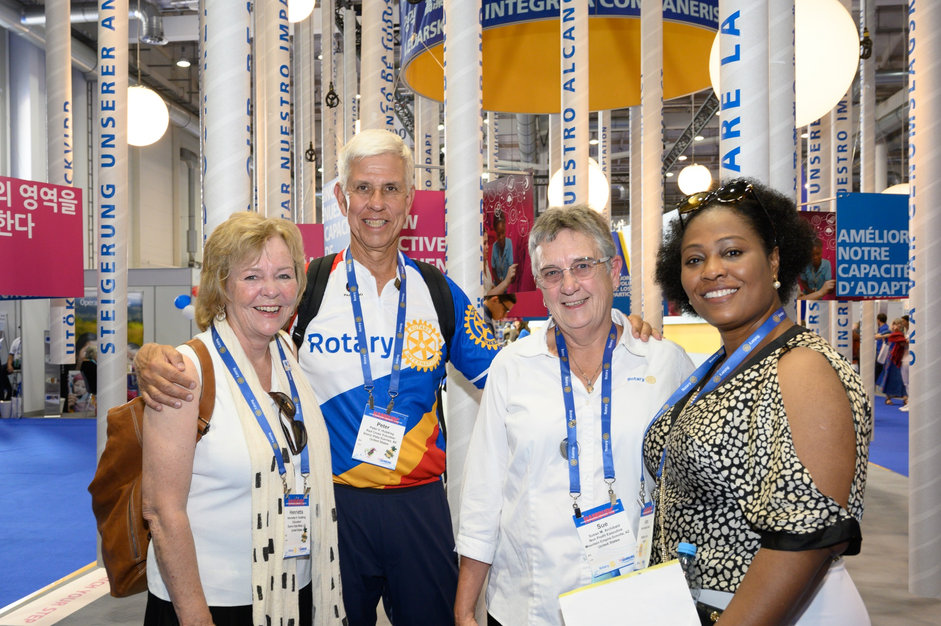
Notes:
Where is the next generation of leadership coming from? We’re in the midst of a huge demographic shift, but while the rising generations share our passion for
community and for making a difference, they have plenty of other places to go to channel that passion—on their phones and in the real world. So what is the plan
address these challenges?

Slide 13

Notes:
Since we are People of Action, it makes sense that this plan is called The Action Plan. It’s a plan that is clear-eyed about the challenges Rotary faces.
It acknowledges the difficult conversations we’ve had at Rotary and must continue to have. Our Action Plan offers the framework and space to surface – and
address – potential disconnects between the goals and needs of clubs and districts and zones and headquarters. Change is hard.

Slide 14
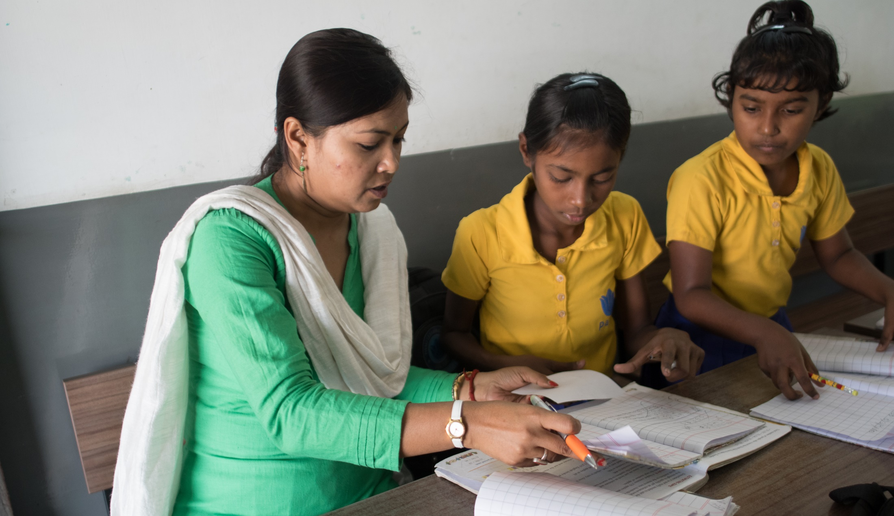
Notes:
Don’t we all want a stronger, more effective Rotary? A Rotary that’s more inclusive and open—to new members and to new ideas. More adept at using
partnerships, digital tools, and other resources to bring people together.

Slide 15
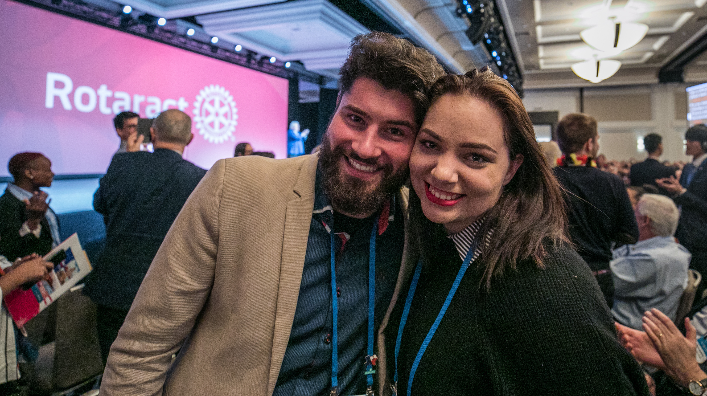
Notes:
The Action Plan helps guide how we’ll achieve this.
As a Rotary leader, you’ve been entrusted with a pivotal role of encouraging buy-in for the plan, and helping clubs realize our priorities over the next five years . .
. a tremendous legacy for the leaders and generations who will follow you.

Slide 16
Five
Years.
Notes:
This Action Plan is ambitious but achievable, with a five-year time frame that will push us but not exhaust us. It’s focused and to-the-point

Slide 17
Four
Priorities.
Notes:
It has four priorities. Four. Each priority reflects the input, feedback, and hopes of current and former members, leadership, Rotaractors, alumni, Youth Exchange
students, and Rotary staff. In all, we reached out to more than a million people who are connected to Rotary in some way to ensure that our Action Plan priorities
are the right ones, and are authentically Rotary. The four priorities are:

Slide 18
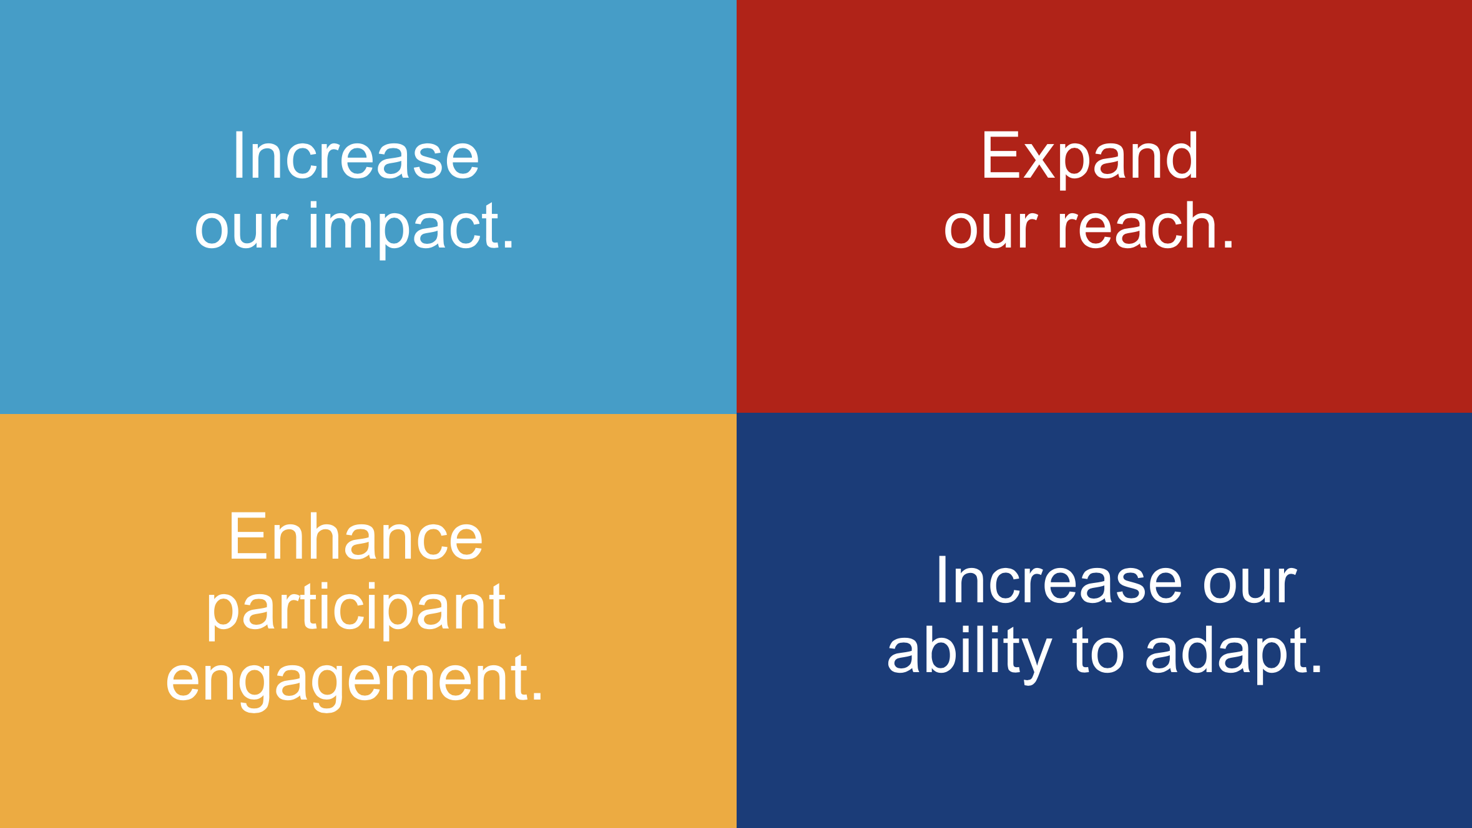
Notes:
Increase our impact;
Expand our reach;
Enhance participant engagement; and,
Increase our ability to adapt.

Slide 19
From Priority to Action.
Notes:
Now let’s look at each one in a little more detail and some of the ways we’ll turn these priorities into action.

Slide 20
Action Plan Priority 1:
Increase our impact.
Notes:
Our first Action Plan priority is to increase our impact. Our actions will answer these questions:
What will our legacy be?
How can we define and measure our impact?
How can we do more good in the world?

Slide 21
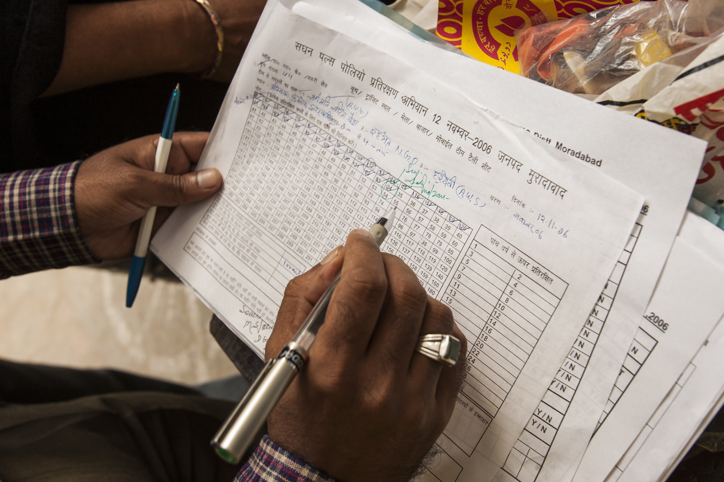
Notes:
In a data-driven world, legacies must be measurable. To increase our impact and provide even more proof of what Rotarians are capable of achieving, we have to
be more data driven.

Slide 22
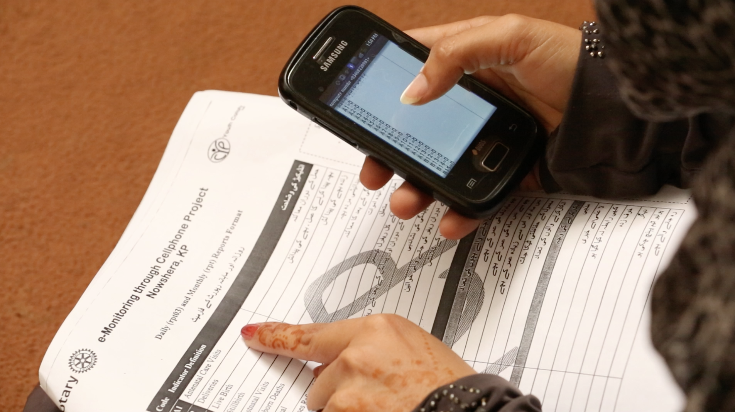
Notes:
This kind of measurement is a best practice in every sector—you probably do something like it in your own profession. And we know that current and potential
partners, as well as younger Rotarians, want to see hard proof of impact. By documenting the metrics of our good works, we get a clear picture of results. We
learn how to replicate and scale up our successes. And we can tell more compelling stories about the good we do.

Slide 23
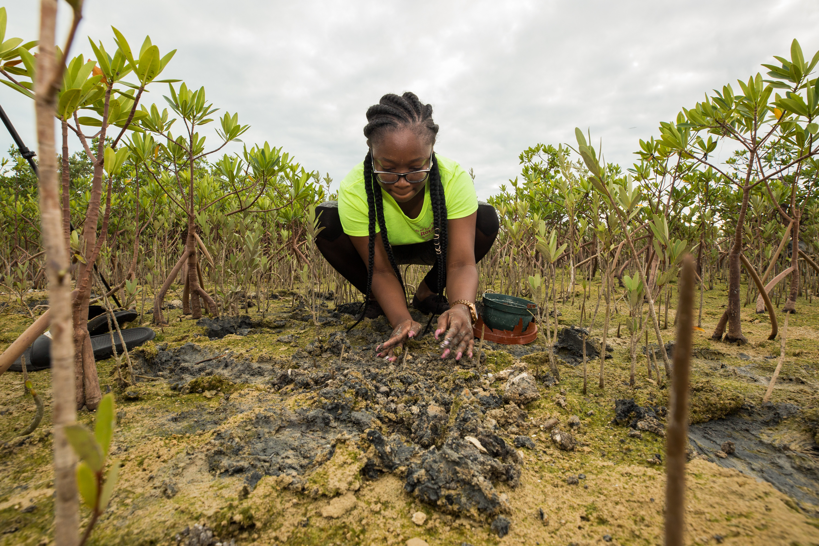
Notes:
There’s a lot we can do at the club level, too. We’re going to encourage a greater sense of focus—instead of clubs trying to do too many things and getting only
halfway there. We’re going to help clubs collect more information on community impact and do pre- and post-activity evaluations, so they can tell compelling
stories about the impact they are making.

Slide 24
Together, let’s prove that our impact on the world has just begun.
Notes:
Together, let’s prove that our impact on the world has only just begun.

Slide 25
Action Plan Priority 2:
Expand our reach.
Notes:
Our second Action Plan priority is to expand our reach so that we can grow our capacity to make an impact. Together, we must answer these questions:
How can we share our values with new audiences?
How can we inspire more people to take action?
What new models can we test that bring people together to experience the power of Rotary?

Slide 26
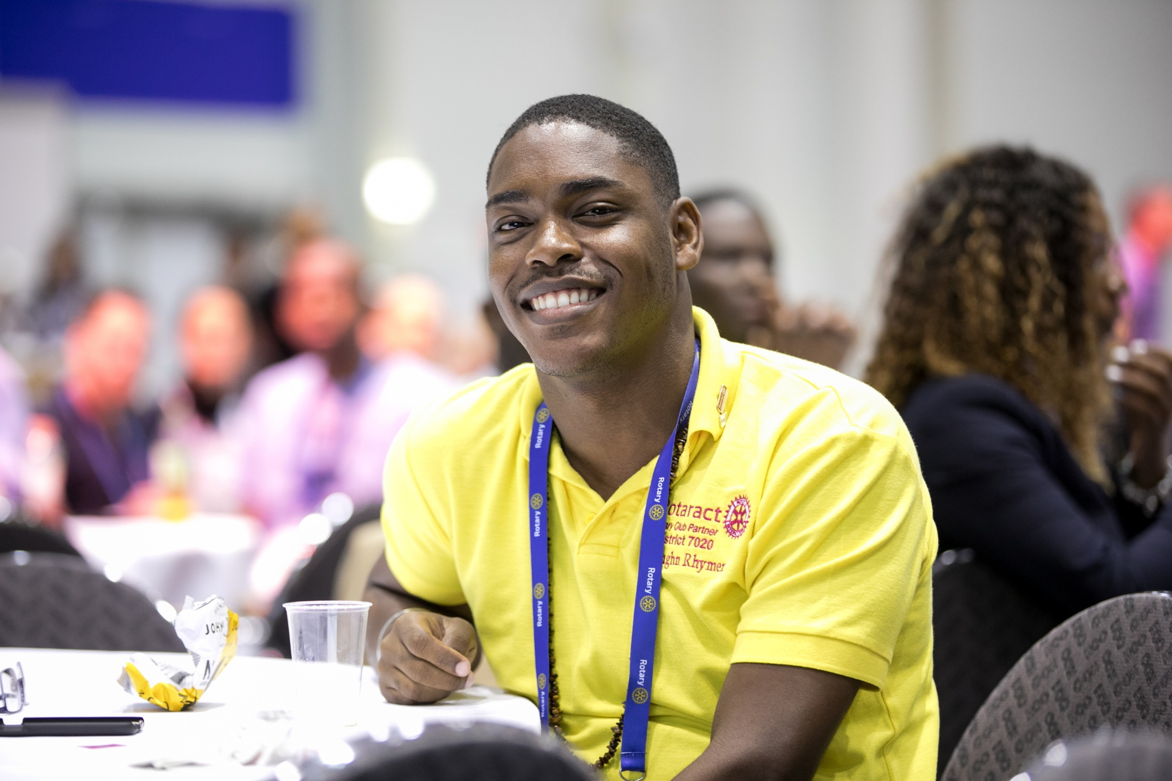
Notes:
Let’s start with those who have already shown an enthusiasm for Rotary. I’m talking about Rotaractors:

Slide 27
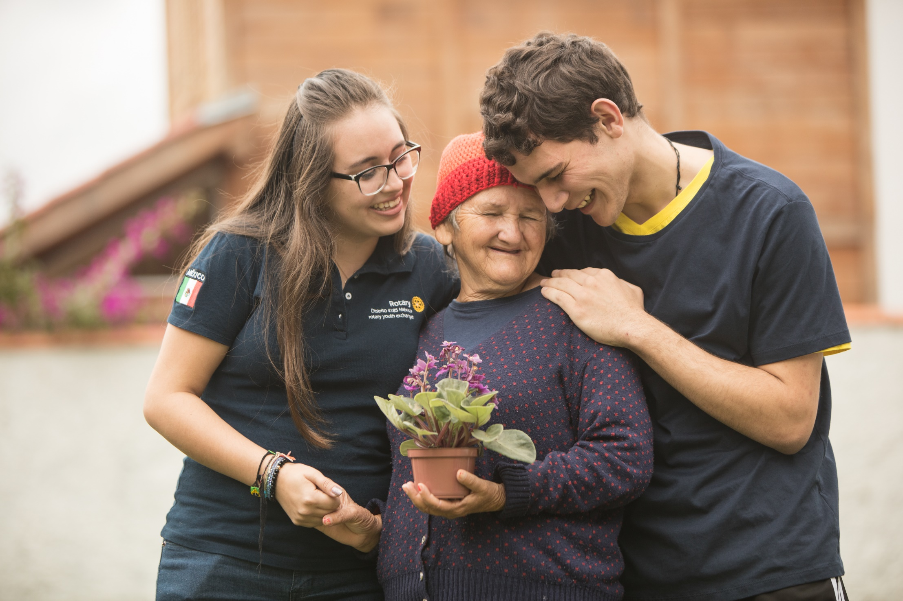
Notes:
they’re energetic, passionate, and driven community-minded professionals. They’re critical to the future of Rotary. That’s why Rotary is conducting research with
them to find out what they want from Rotary and how we can attract others like them.

Slide 28
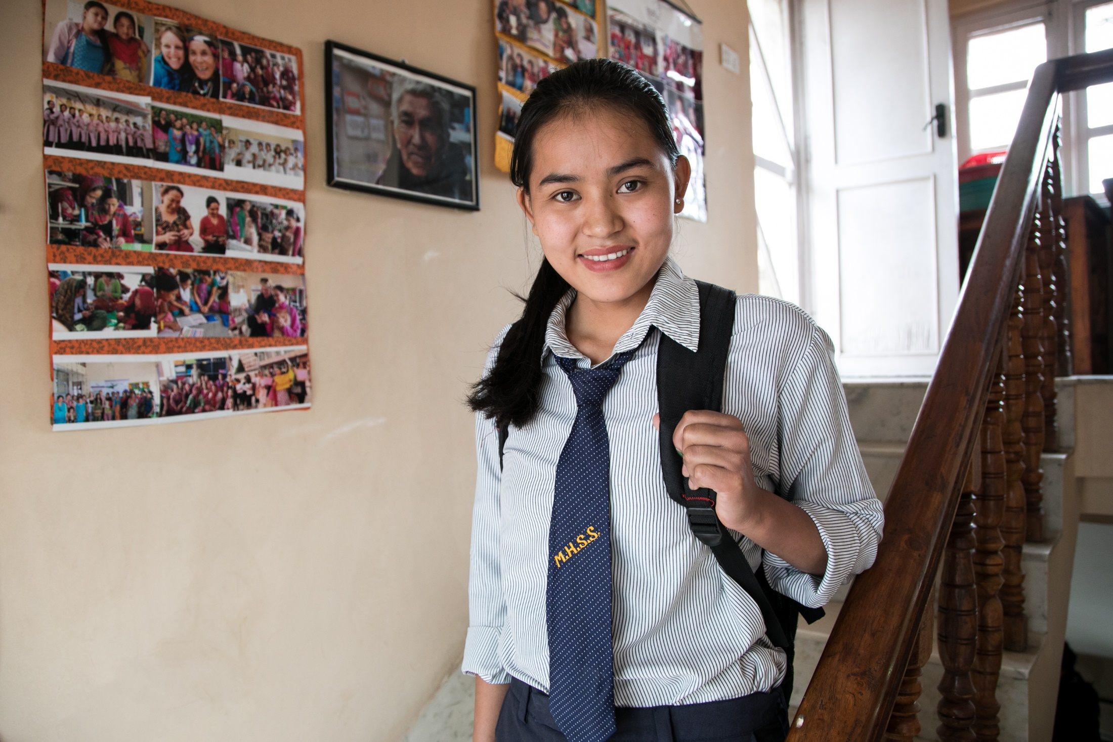
Notes:
At the corporate level, Rotary is developing new products and alternative participant models—so regardless of where people live, they can join us and take action with us.
At the club level, we need to actively invest in bringing in more people from different backgrounds.

Slide 29

Notes:
There are so many ways to create new channels into Rotary—bringing family members to events, involving local Rotaractors, updating clubs’ websites and social media pages.
There are all kinds of leaders in communities, and we want those leaders connected to Rotary. So let’s open up our thinking about who a leader can be, and then
reach out to these new people: start a dialogue about how we can mutually benefit from their participation in our activities and events.

Slide 30
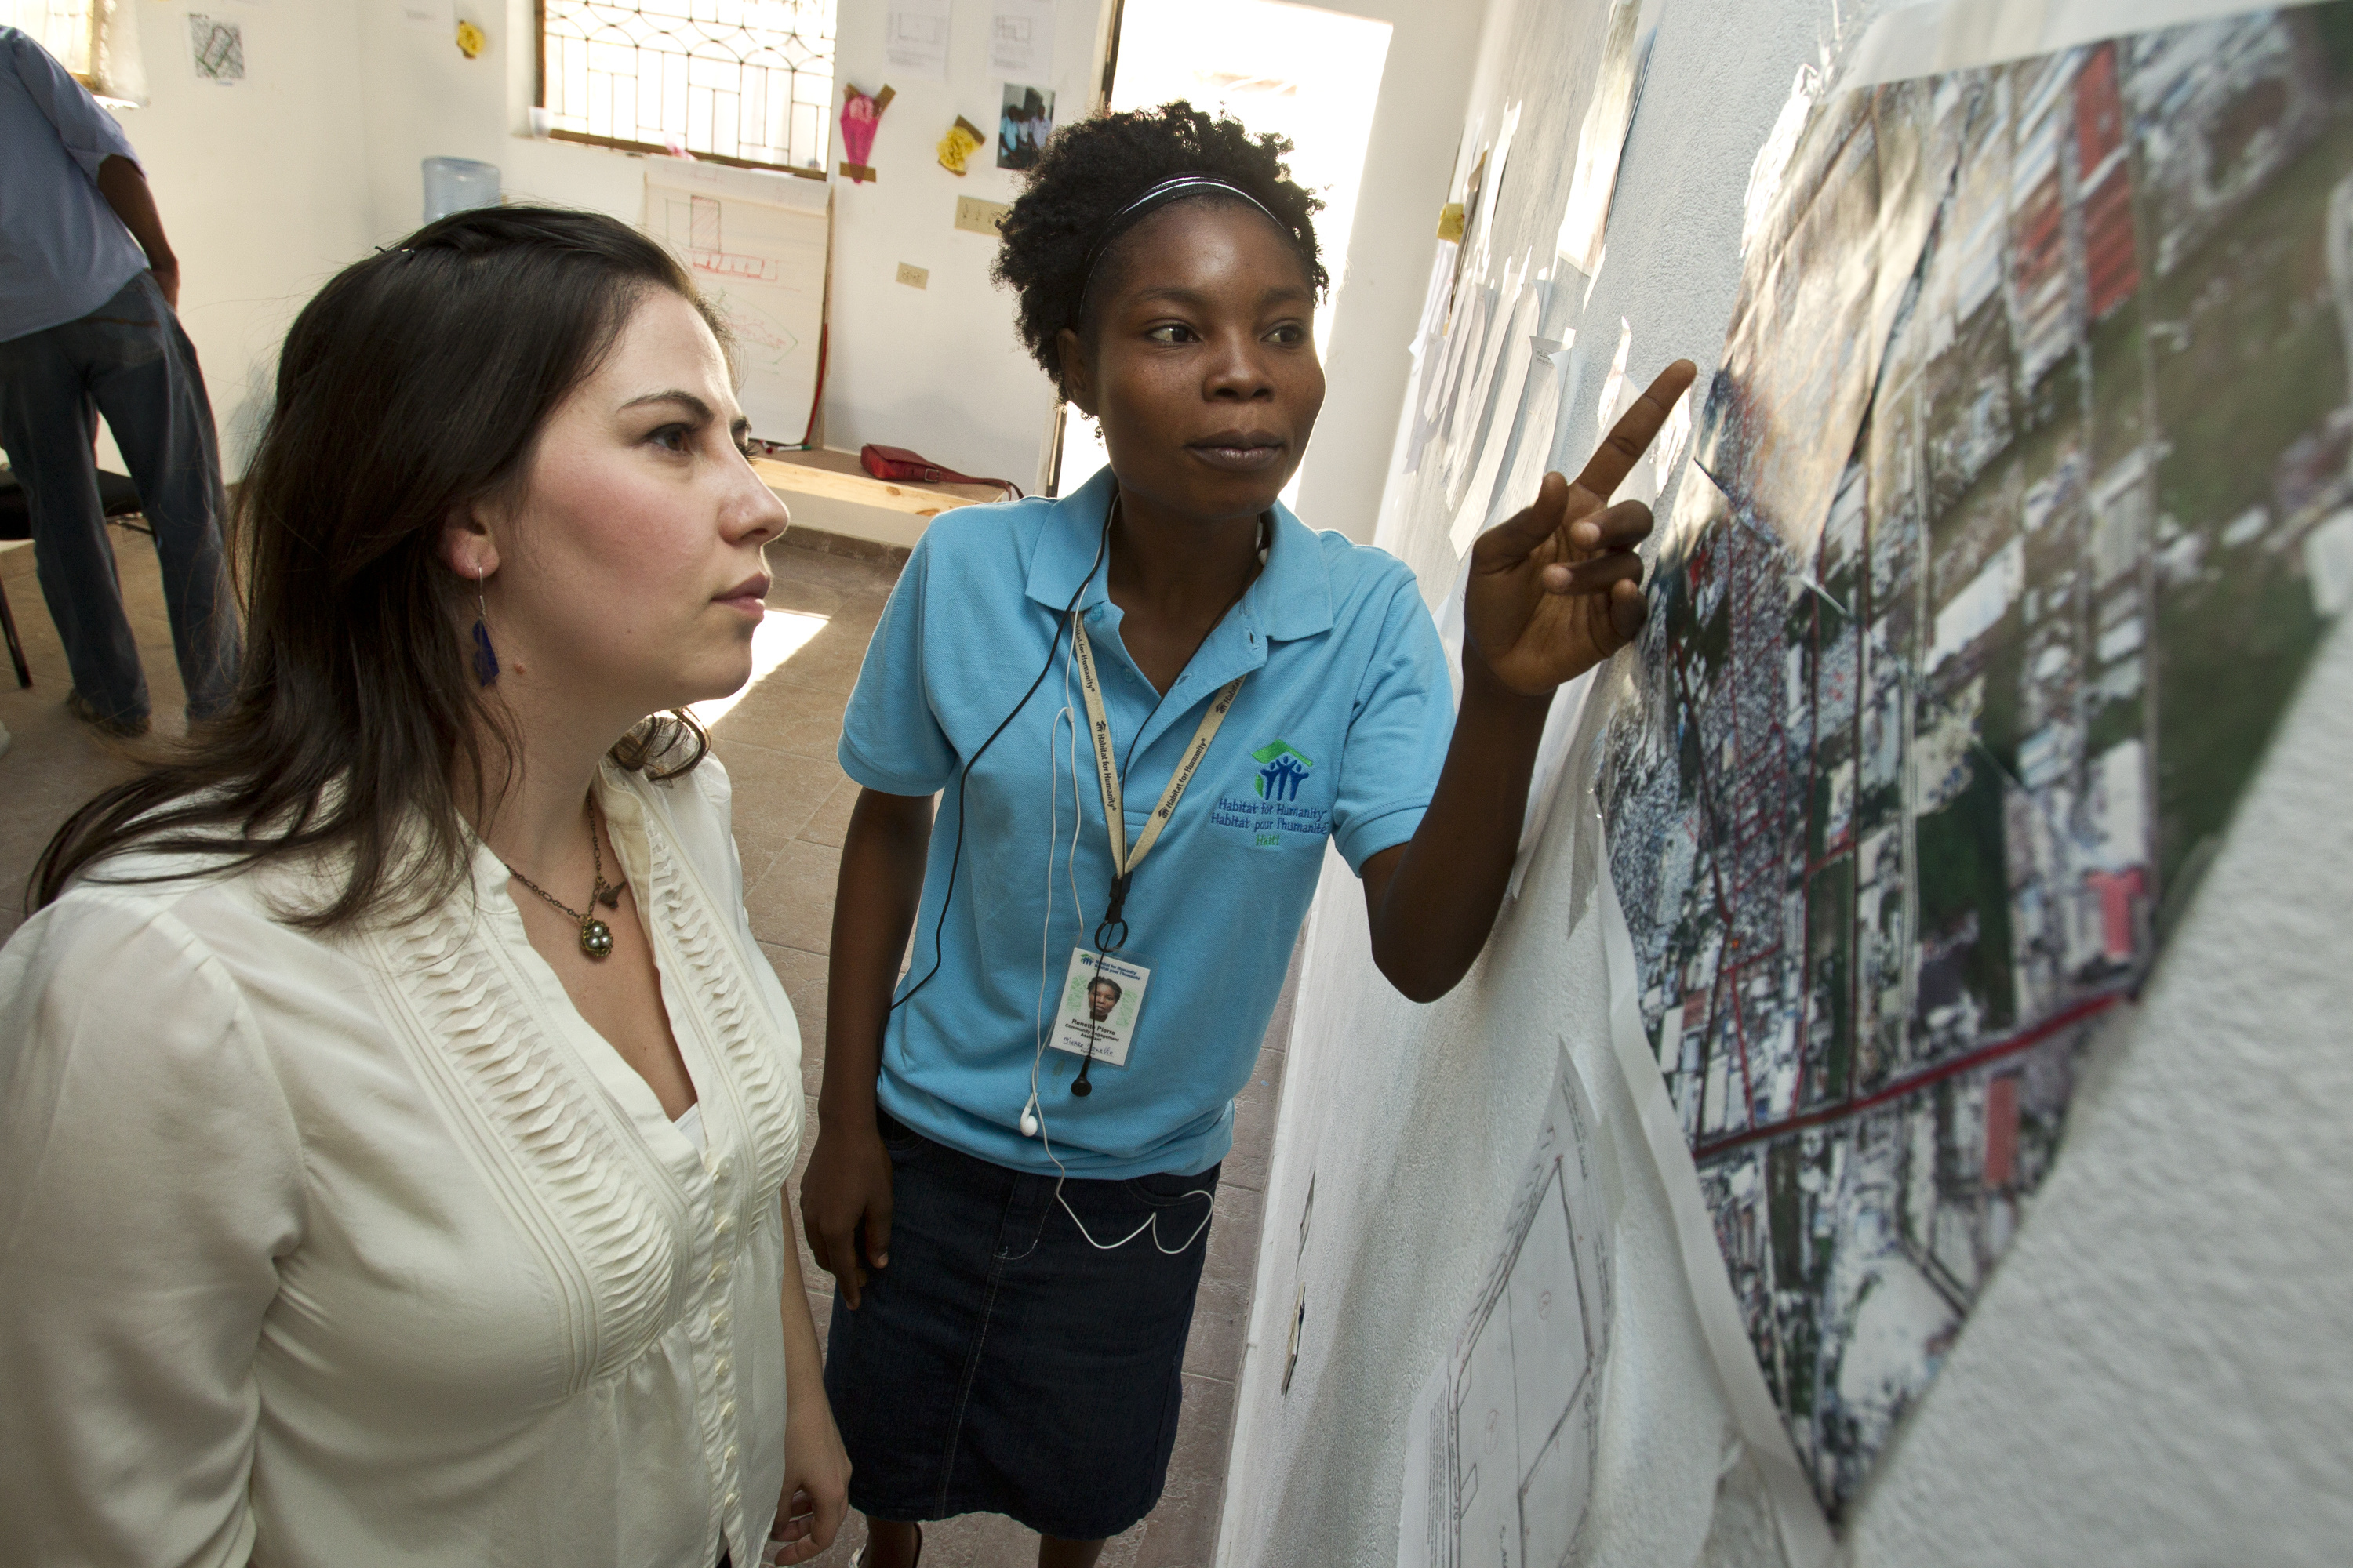
Notes:
Here’s another way to revitalize our clubs and share our values with new audiences: form partnerships with new organizations and agencies. Already Rotary clubs partner with schools and universities, the local chamber of commerce, local governments, social service agencies, other volunteer organizations. That’s fantastic. But we need to encourage every club to do more to collaborate with and involve their communities. Let’s look around our communities and see all the ways that people are connecting—through shared professional goals, for example, or shared cultures or interests. And let’s invite those people to connect with us, too. When we think beyond traditional partnerships we show we’re an open, engaging organization. We demonstrate that positive change starts with welcoming the talents and ideas of others.

Slide 31
Together, let’s build connections and opportunities that will allow people who
share our drive to do the same.
Notes:
Together, let’s build connections and opportunities that will allow people who share our drive to do the same.

Slide 32
Action Plan Priority 3:
Enhance participant engagement.
Notes:
Our third Action Plan priority is to enhance participant engagement. Our actions will answer these questions:
How can we make sure Rotarians find long-term value in their membership?
What would improve the Rotary experience?
What skills could people learn through Rotary?
How can we better develop our leaders?

Slide 33
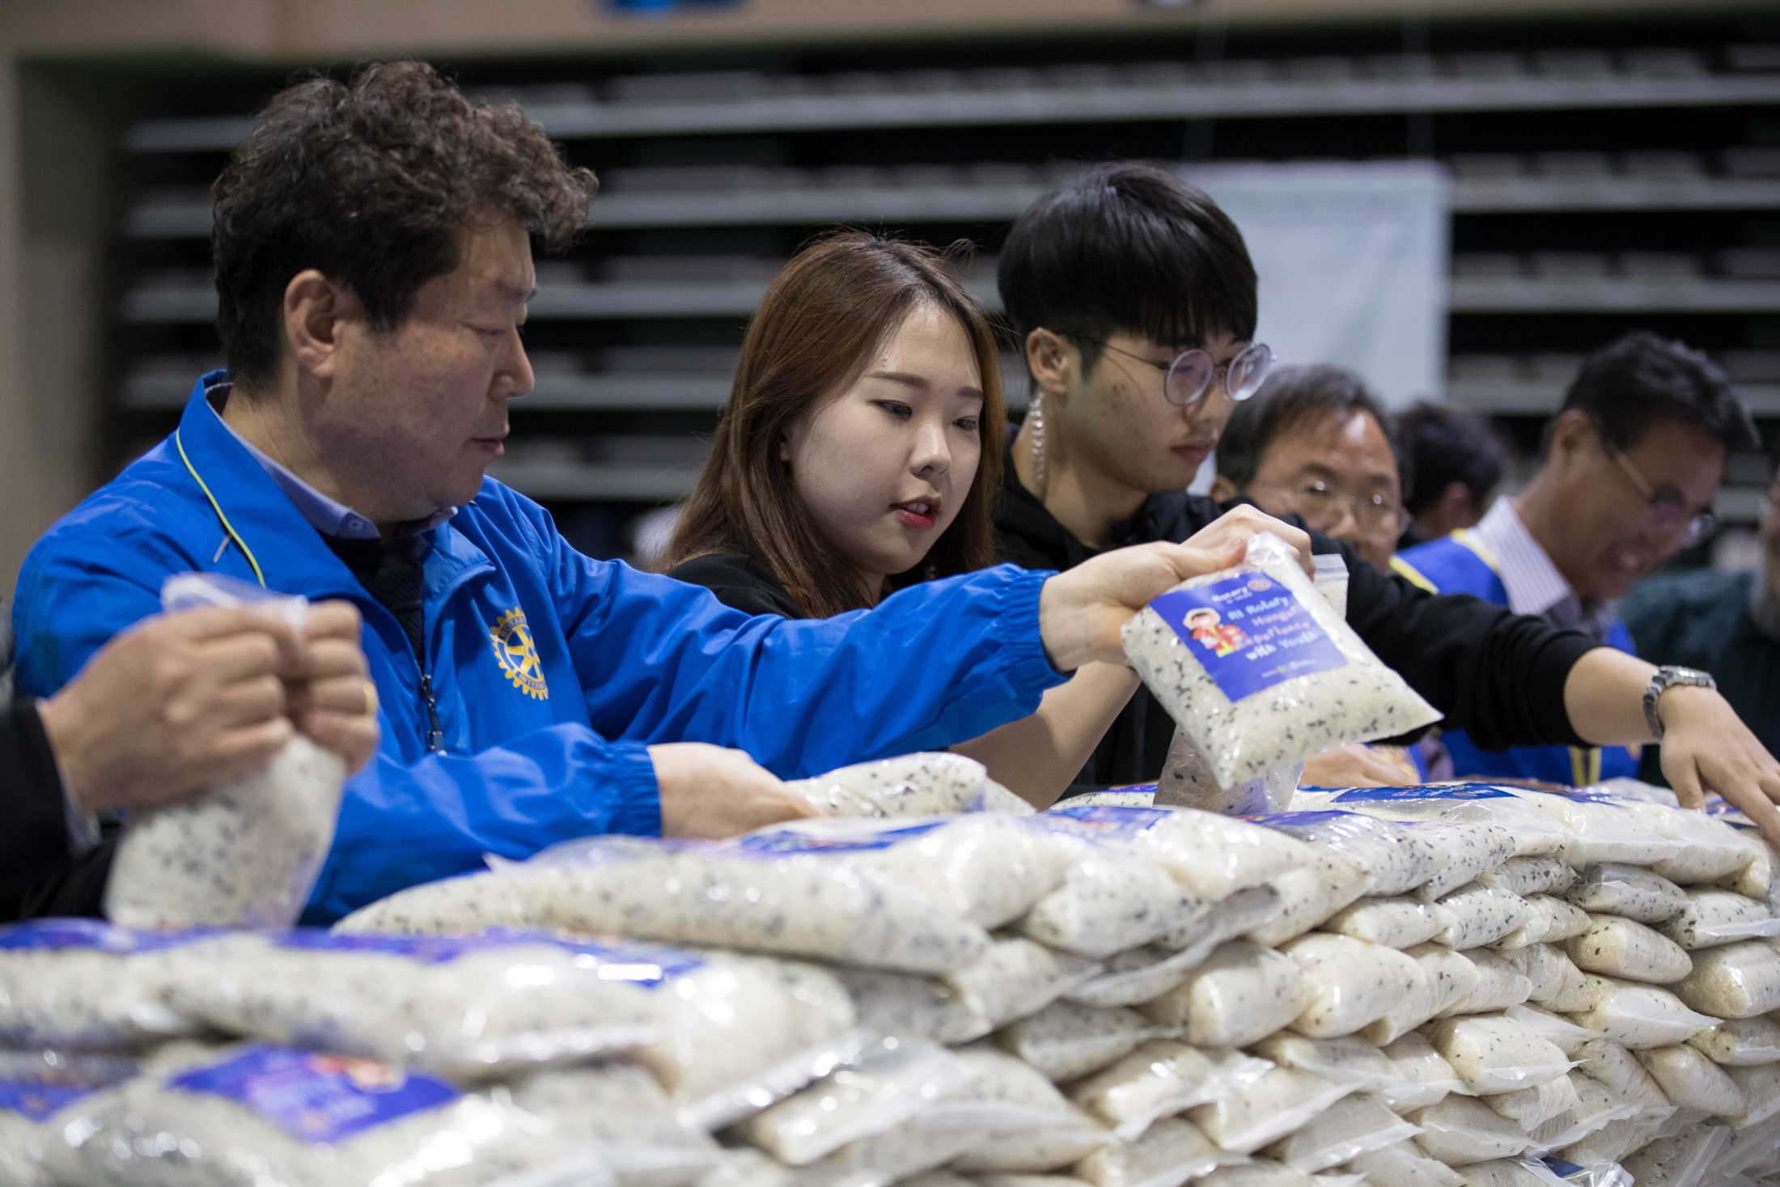
Notes:
As People of Action we strive to understand the needs of others. But just like the people and communities we serve, our fellow members need to know that they
are seen, heard and valued. They’re seeking experiences that feel personally and professionally relevant and fulfilling and, in some cases, we are not delivering on
that need. This priority is aimed at making sure that we give our members meaningful opportunities to evolve and grow with us – personally and professionally–
throughout their lives.

Slide 34

Notes:
But let’s not stop with our members. We want to improve the overall Rotary experience for anyone who affiliates with us. And we should take nothing for
granted. We need to look at every encounter as an opportunity to show our people what Rotary can do for them—as individuals and as members of our
communities.

Slide 35
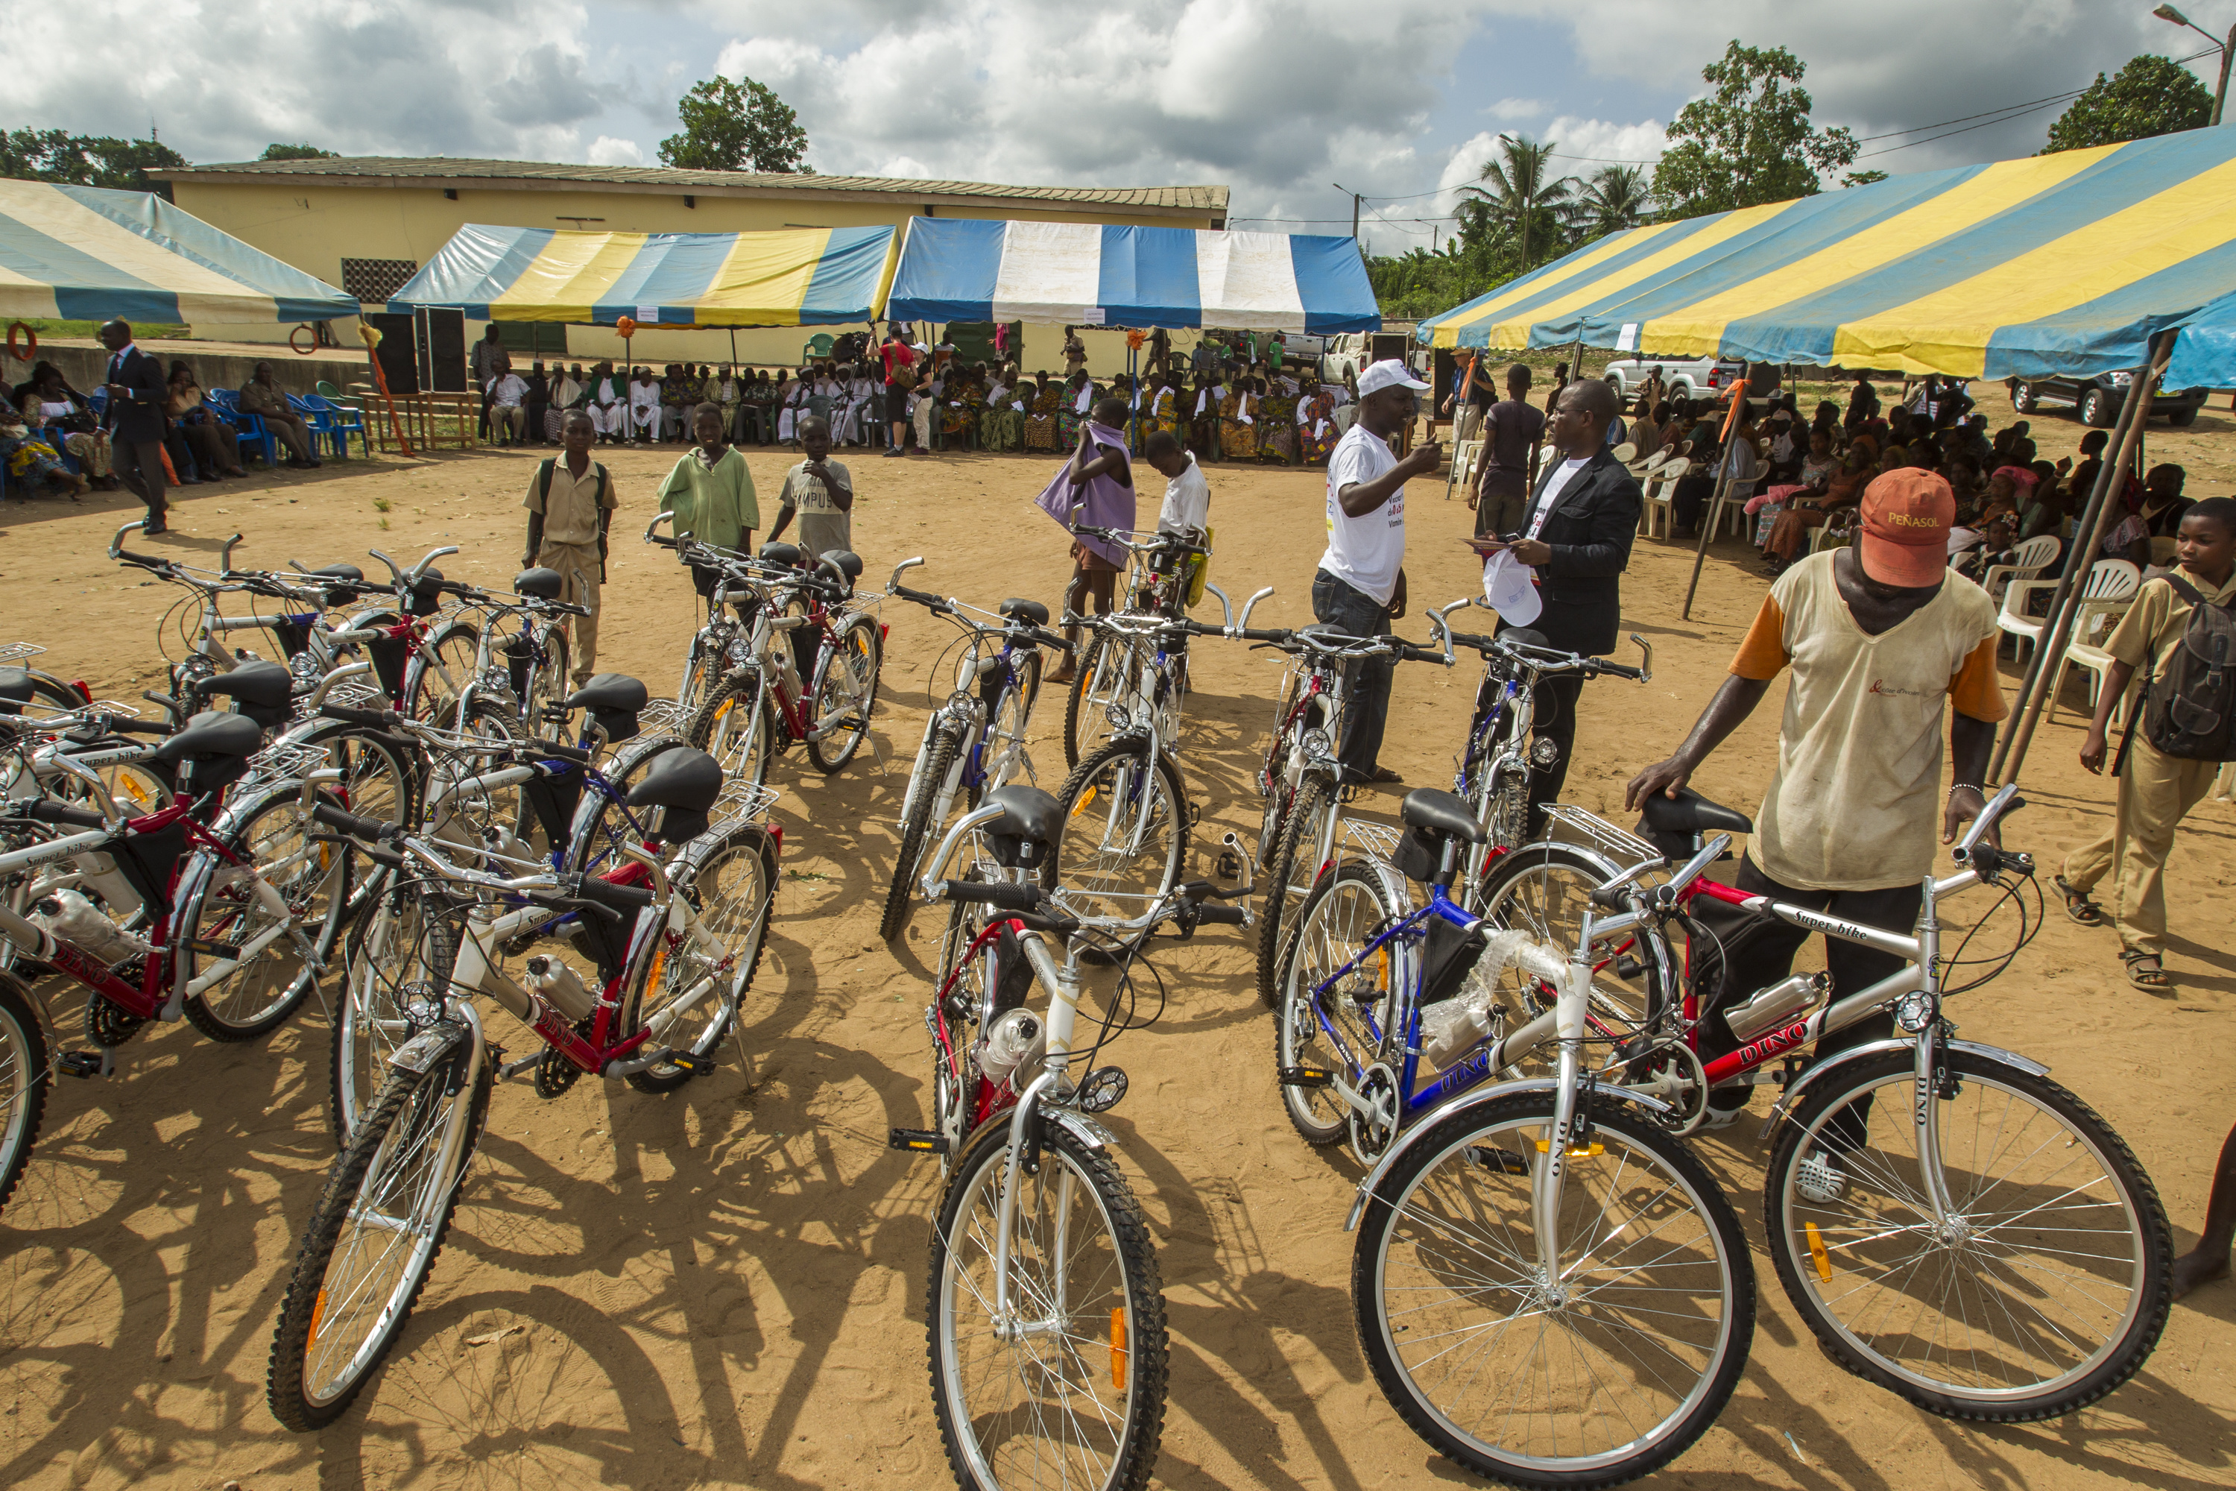
Notes:
Let’s create the space for members, participants, and the community at large to provide regular feedback on their experiences and needs. Let’s not wait for a
community need to present itself to us: let’s be proactive and become known as the people who spot opportunities for positive change that no one else sees.

Slide 36
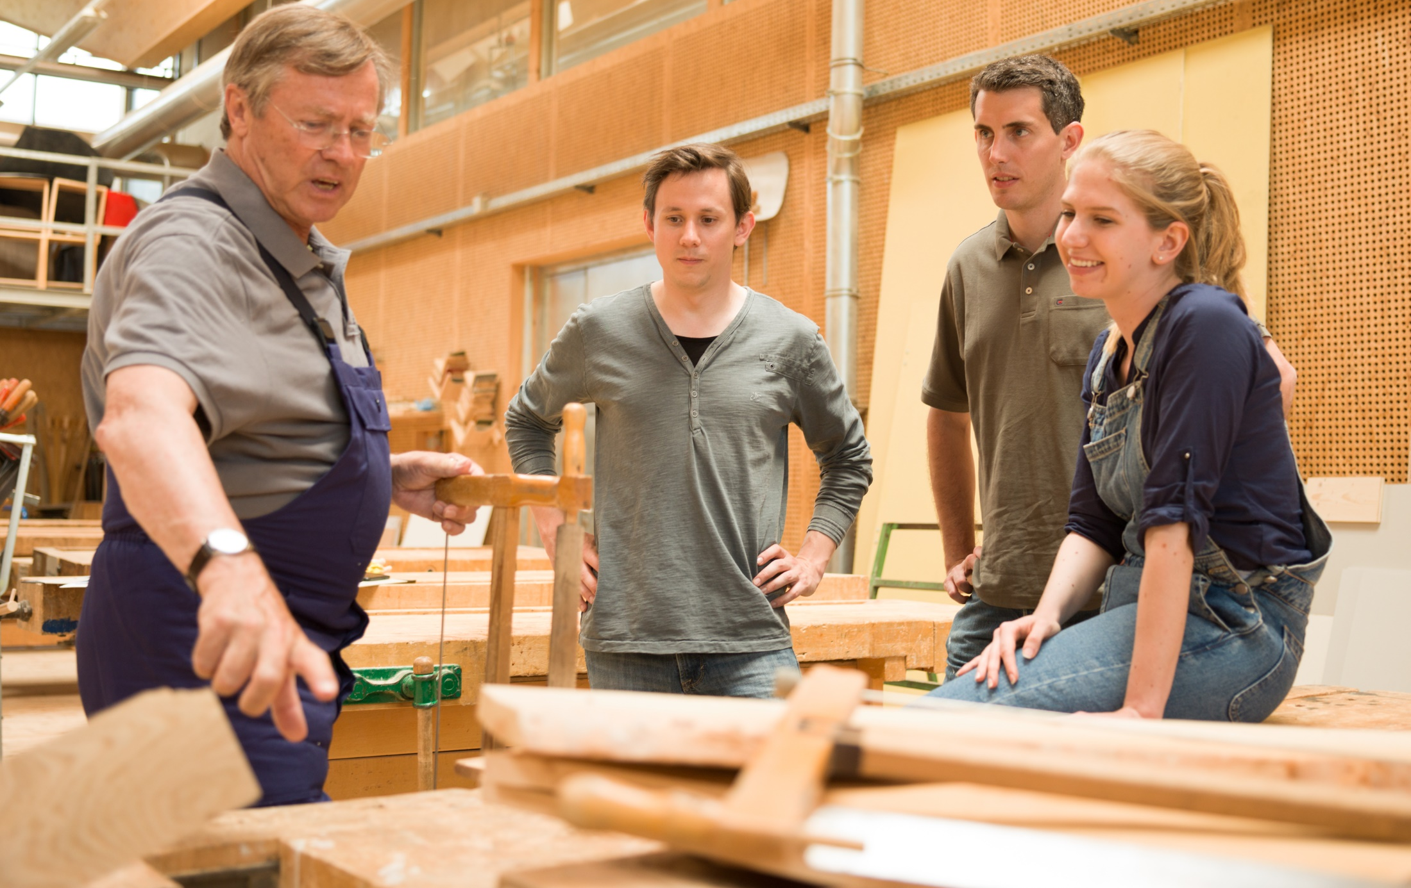
Notes:
And let’s take a hard look at what happens when people volunteer with us or attend our events. Are we doing everything we can to say, “We’re thankful you’re here. You matter to us”?

Slide 37
Together, let’s recommit to putting
the needs, expectations, and growth of our participants at the center of all we do.
Notes:
Together, let’s recommit to putting the needs, expectations, and growth of our participants at the center of all we do.

Slide 38
Action Plan Priority 4:
Increase our ability to adapt.
Notes:
Our fourth Action Plan priority is to increase our ability to adapt. Our actions will answer these questions:
How can we adapt faster to a changing world?
How can new perspectives strengthen Rotary?
What new ideas could create lasting change?

Slide 39
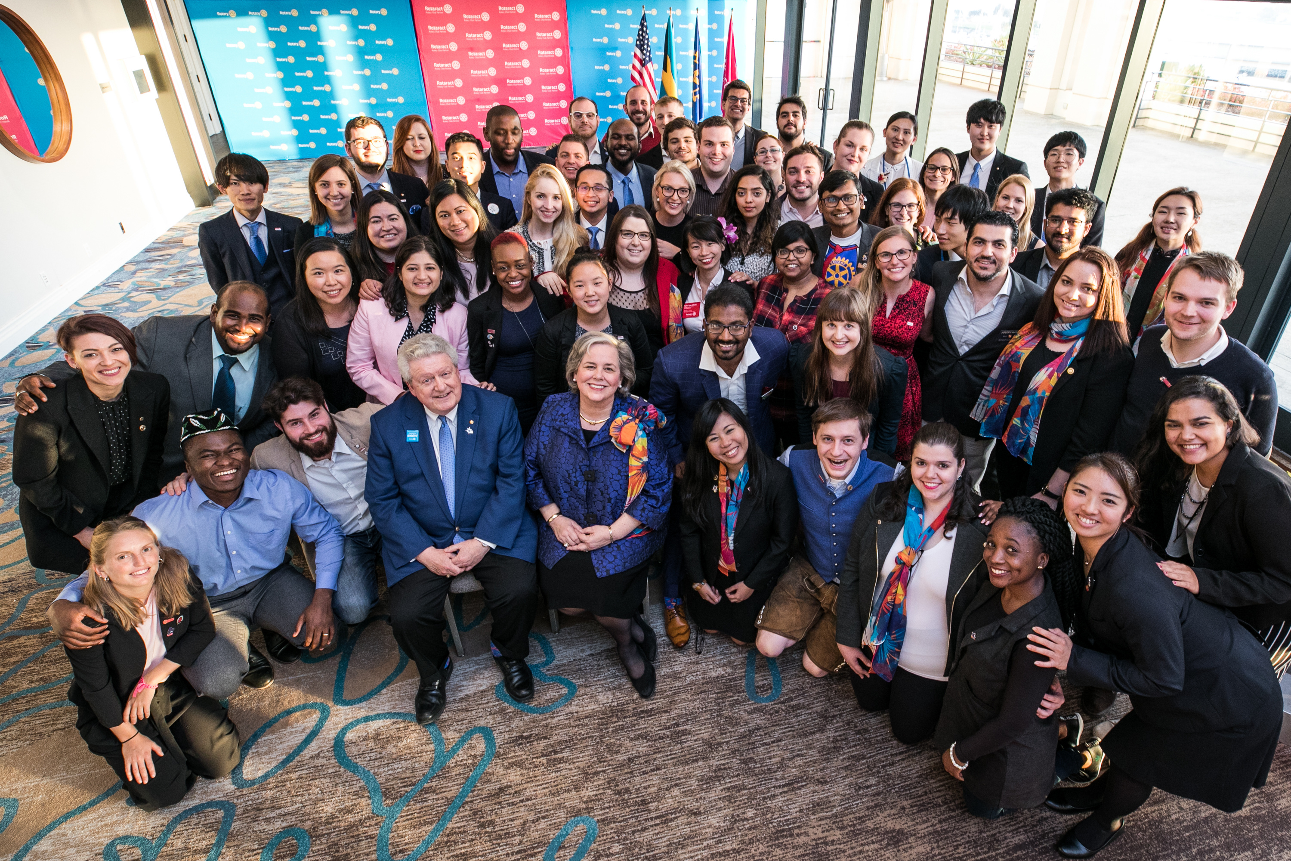
Notes:
As we explore and implement new approaches to our organizing principles it should not threaten our sense of who we are.
It’s time for us to seek out fresh opportunities, to embrace innovative ideas and take calculated risks. We must create more paths to leadership, welcome new
voices, and simplify how we operate.

Slide 40
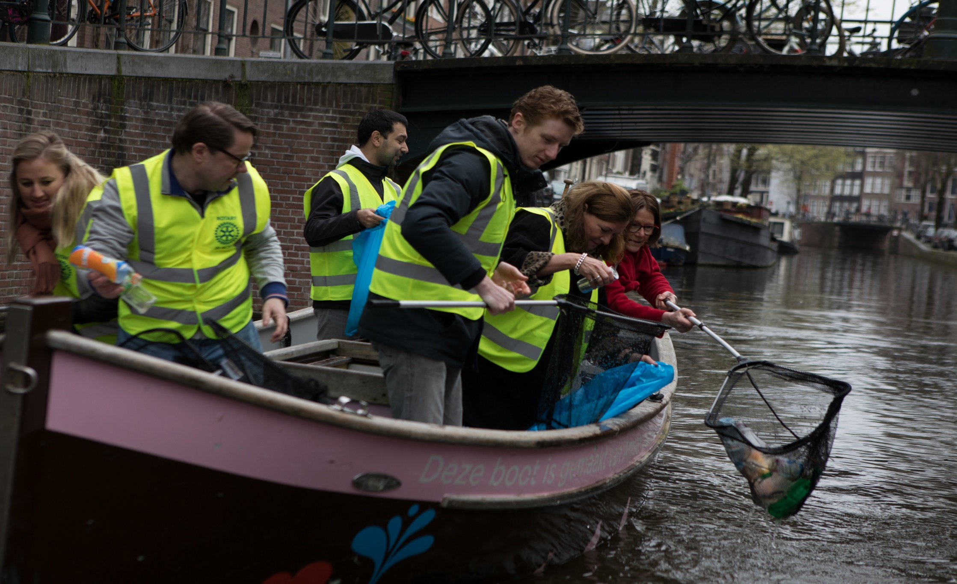
Notes:
We’re already tackling some of the big operational issues. We’re going to look at governance models, committee structures, business processes at the secretariat
level and more. Everything is on the table.

Slide 41
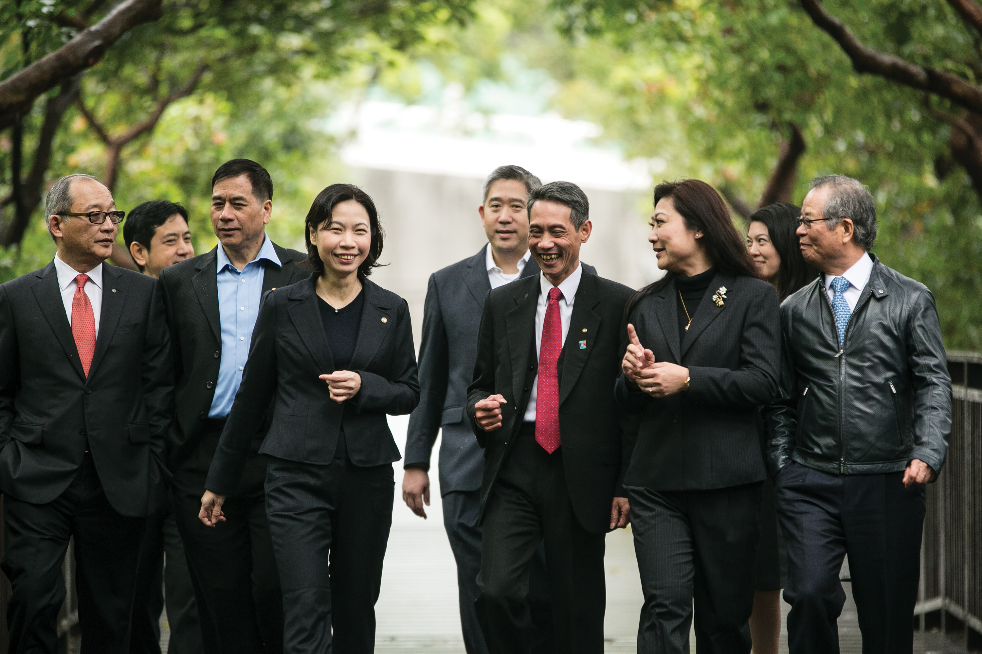
Notes:
Many of you have been through this kind of deep dive into internal processes in your own companies and organizations. You know it isn’t glamorous. But you
also know it’s absolutely essential if we want to create a strong foundation for innovation, sustainability, and growth.

Slide 42
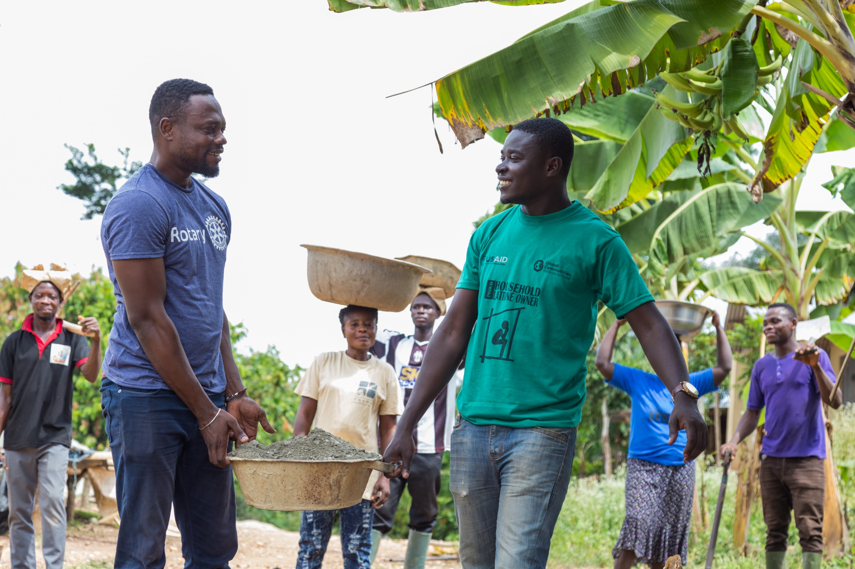
Notes:
We should also encourage our clubs to take a fresh look at club governance and look at ways to streamline it. They can create a fund to take some risks and try
out new activity ideas. They can host the club meeting in a new location and at a new time. They can involve non-Rotarian advisors in club board meetings to gain
new and different perspectives and ideas.

Slide 43
Together, let’s stay true to ourselves and
stay ahead of change in our next 115 years.
Notes:
Together, let’s stay true to ourselves and stay ahead of change in our next 115 years.

Slide 44
rotary.org/actionplan
Notes:
If you have any questions about the Action Plan or how you can get involved, or to stay updated on our progress, go to our website: rotary.org/strategicplan.

Slide 45
The Rotary Action Plan
Notes:
While each one of these priorities must be owned by all of us, we don’t have to address them in the same way.
Let’s play to our strengths as leaders, as clubs, and as members. There is much we can do at the corporate level in terms of operations and infrastructure. And
there is much that can be done at the club and person-to-person level so that every person who engages with us has a meaningful, valuable, and fulfilling
experience. Working together, doing what each of us does best, we can make a stronger Rotary, and change more lives and communities for the better.

Slide 46
Questions?

